Slide 1
Get Away From GTA
By: Abdul Qadi, Anna Liang, Joe Chaaya, Lewis Ifeanyichukwu Iwhere and Rohith Suresh

Slide 2
Elevator Pitch-Joey
We know everybody likes getting away and taking vacations. We also know that nobody likes all of the work that comes with planning a vacation. That’s where Get Away from GTA comes into play. Simply enter your desired destination and our software will provide you with the current weather along with popular attractions in the area so that you don’t miss out on any of the areas greatest attractions.

Slide 3
Description-Lewis
To begin enter the destination of your choice, it can be anywhere in the world. With the information given Get Away from GTA will then provide you with your destinations current temperature as well as provide you with popular attractions in the area that you may wish to partake in while you are there.

Slide 4
Motivation for Development- Anna
Our motivation for development was that we all like to travel and get away from the GTA from time to time, despite how great it is, but nobody likes all of the work that goes into planning a trip. With all of this in mind we set out to develop a software that aims to give the user some information to help them make an informed decision before travelling.

Slide 5
User Story-Abdul
GIVEN a search bar for location
WHEN I enter a city
THEN a drop-down options for destinations appear
WHEN I choose one of the destinations
THEN weather information, and lists of attractions appears
WHEN I search for a new city
THEN a list of previously searched cities and their weather data appears

Slide 6
Technologies used -Abdul
HTML
CSS
JQUERY
JAVASCRIPT
APIs

Slide 7
Breakdown of Tasks-Joey
HTML – Anna, Lewis
CSS – Anna, Lewis
JavaScript – Abdul, Rohith
Finding and implementing APIs – Abdul, Joe and Rohith
Powerpoint – Joe
ReadMe- Anna
GitHub – Rohith
Logo - Lewis

Slide 8
Challenges- Joey
Challenges included getting our websites design layout to meet our imagined image
Finding APIs that could perform the task we desired while still being free of charge
Integrating multiple APIs was also a challenge
Balancing personal and work lives while trying to meet and work on the project

Slide 9
Successes-Joey
We were able to get our websites design layout to meet our standards.
We were able to find APIs to suit our needs
We were able to integrate multiple APIs
We were able to collaborate and work together despite all of our other personal and professional commitments

Slide 10
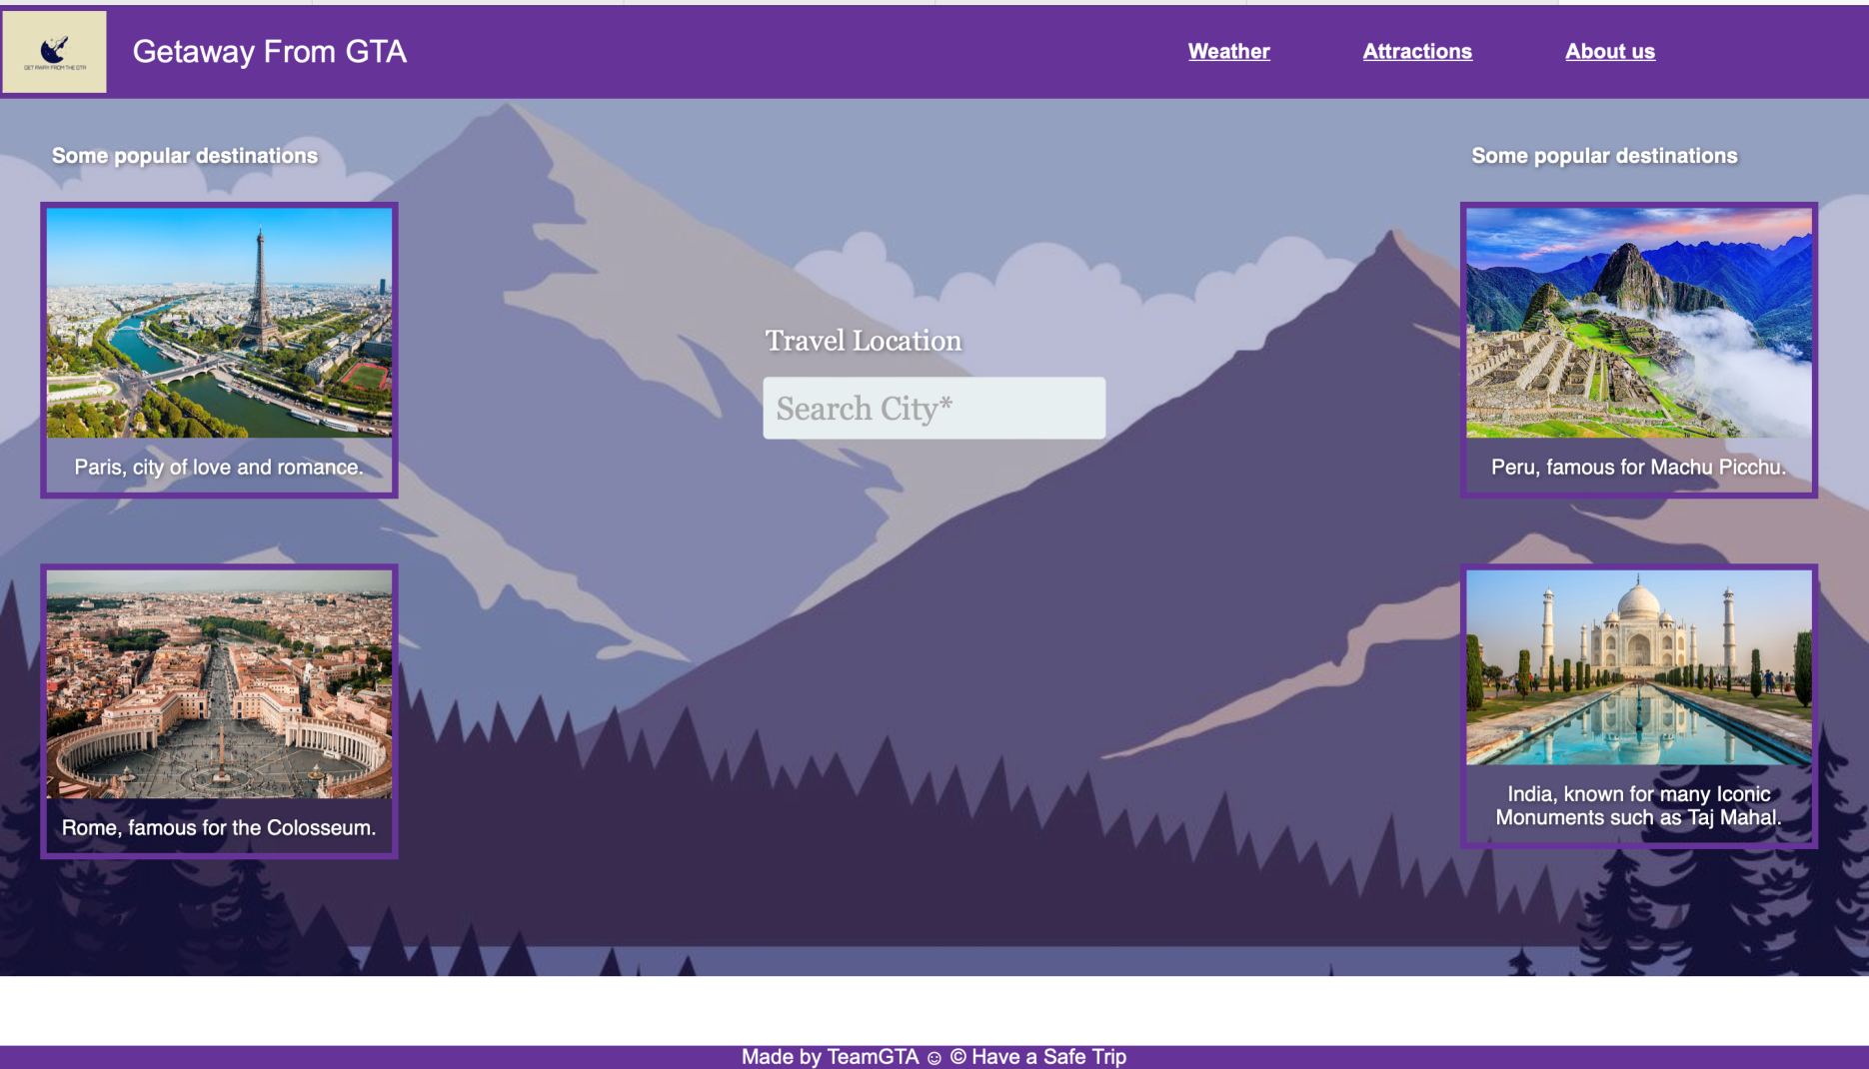
Demo-Rohith

Slide 11
Directions for Future Development - Rohith
Future Development might include finding more capable APIs.
Such APIs might include flight information
booking systems for hotels
Restaurants
A range of future weather data

Slide 12
Links - Rohith
Deployed: https://teamgta.github.io/GetawayfromGTA/
GitHub repo:
https://github.com/TeamGTA/GetawayfromGTA

